Slide 1

Customization Interfaces
Insyde Software March 2021

Slide 2
Copyright 2021 Insyde Software Corp., All Rights Reserved.
No part of this publication may be reproduced, transmitted, transcribed, stored in a retrieval system, or translated into any language or computer language, in any form, or by any means, electronic, mechanical, magnetic, optical, chemical, manual or otherwise, without the prior written permission of Insyde Software Corp.
Disclaimer
Insyde Software Corp. (“Insyde”), provides this document and the programs "as is" without warranty of any kind, either expressed or implied, including, but not limited to, the implied warranties of merchantability or fitness for a particular purpose.
This document may contain technical inaccuracies or typographical errors. Changes are periodically made to the information herein; these changes will be incorporated in future revisions of this document. Insyde is under no obligation to notify any person of the changes. Some code names featured in this document are used to identify products that are in development and not yet publicly announced for release. Insyde is not obligated for its accuracy or completeness.
This document may contain third party’s information, features, schedules, code names, and product names, which are based on Insyde’s interpretation available as of the creation of this document and may be changed from time to time. Neither Insyde nor the third party is obligated to notify such change. If you are interested in third party’s information, you may contact the local third party sales office or the local distributor to obtain the latest specifications. All the intellectual property right of any third party information remains to its owner or steward.

Slide 3
Agenda
Introduction
How to Customize via OEM Services
How to Change PCDs at Build Time
How to Use Override
Internal Use

Slide 4
Introduction

Slide 5
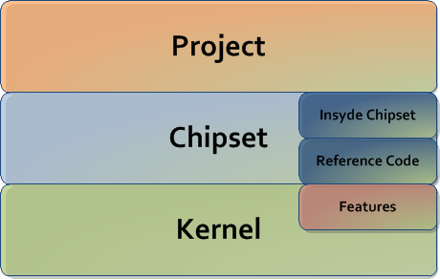
Introduction Customization Interface Overview
Goal: Simplify Customization
PCDs
OemSvcKernelLib\OemSvcChipsetLib
CRB or OEM
Board support code
Chipset feature
support code.
Industry-standard or
Insyde feature
support code

Slide 6
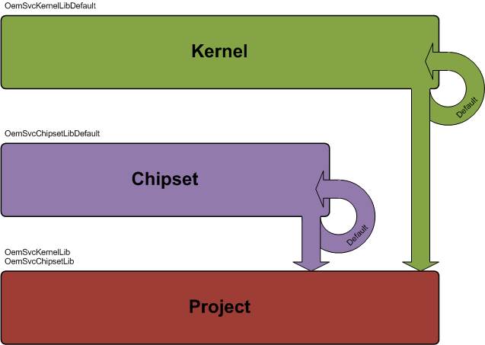
Introduction Standardized OEM Customization Style
Kernel Calls OEM Service.
Default Version Of Each Function In Kernel
Chipset Calls OEM Service.
Default Version Of Each Function In Chipset
Project Provides Only Functions Needed

Slide 7
Introduction OEM Service Library
Use the same style of OEM customization for all Insyde provided Kernel and Chipset code.
One file for each function
Each file named after function .C (i.e. xxx()  xxx.c)
OEM Kernel Service Library – Customize Kernel
BaseOemSvcKernelLib, PeiOemSvcKernelLib, DxeOemSvcKernelLib, SmmOemSvcKernelLib
Library definition in Insyde/InsydeOemServicesPkg/Include/Library/*.h
OEM Chipset Service Library – Customize Chipset
BaseOemSvcChipsetLib, PeiOemSvcChipsetLib, DxeOemSvcChipsetLib, SmmOemSvcChipsetLib
Library definition in Intel/xxx/xxxChipsetPkg/Include/Library/*.h

Slide 8
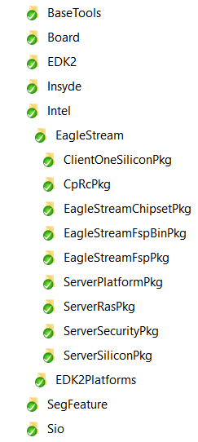
InsydeH2O 5.4 Code Structure Insyde Source Code Structure – Eagle Stream
From Intel
Chipset
Project
Insyde H2O Kernel

Slide 9
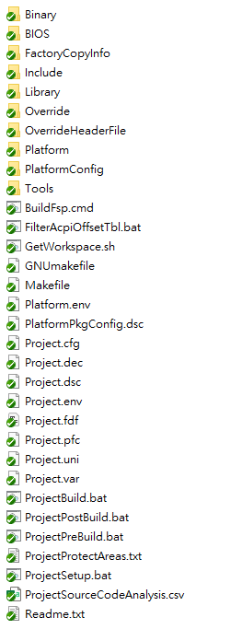
Introduction Project Code Package (Board Package) – Eagle Stream
Customize the OEM Services in Library folder
Change the PCD values in Project.dsc

Slide 10
How to Customize Via OEM Services

Slide 11
How to Customize via OEM Services The Return Status
Return Status: EFI_UNSUPPORTED
LibDefault
Return Status: EFI_MEDIA_CHANGED
Customized value will be passed
Return Status: EFI_SUCCESS
Replaces original programming code

Slide 12
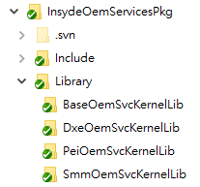
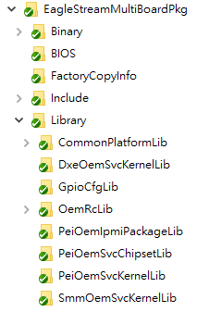
How to Customize via OEM Services
Check the “$(PROJECT_PKG)/Library” folder
If the OEM Service Lib folder hasn’t been used before, create it

Slide 13
How to Customize via OEM Services
Modify the XxxOemSvcYyyLib.inf
Xxx: Base/Pei/Dxe/Smm
Yyy: Kernel/Chipset
If the folder has been created by the previous step, copy this file from original folder
Remove or mark out the interfaces you don’t use, just keep the interfaces you want to modify
[Sources]
OemSvcModifyGpioSettingTable.c
OemSvcUpdatePeiCpuPlatformPolicy.c
[Sources]
OemSvcModifyGpioSettingTable.c
# OemSvcUpdatePeiCpuPlatformPolicy.c

Slide 14
How to Customize via OEM Services
Customize the interface based on your project, and provide the right return status (EFI_MEDIA_CHANGED or EFI_SUCCESS ?)
EFI_STATUS
OemSvcModifyGpioSettingTable ( … )
{
/*++
Todo:
Add project specific code in here.
--*/
return EFI_UNSUPPORTED;
return EFI_MEDIA_CHANGED;
}

Slide 15
How to Customize via OEM Services Be Careful When Using EFI_SUCCESS
Unimplemented function will return EFI_UNSUPPORTED.
Supplied by Default version of the library.
Task replacement function will return EFI_SUCCESS.
Replaces entire Kernel/Chipset implementation of task.
Parameter modification function will return EFI_MEDIA_CHANGED.
Just changes contents of configuration parameters.
In the OEM Service Library be very careful about the “Return Value”. If you don’t really understand the Caller’s action, don’t return EFI_SUCCESS. The caller may skip a later step and presume this XXXOemSvcYYYLib function has taken care of it, even if this function doesn’t correctly control it . The caller may not function or the system may hang up!!!

Slide 16
How to Change PCDs at Build Time

Slide 17
How to Change PCD at Build Time
$(PROJECT_PKG)/Project.dsc
[PcdsFeatureFlag]
gEfiSamplePkgTokenSpaceGuid.PcdFlag|FALSE
[PcdsFixedAtBuild]
gEfiSamplePkgTokenSpaceGuid.PcdFixed|0x21
[PcdsPatchableInModule]
gEfiSamplePkgTokenSpaceGuid.PcdPatch|0x4321
[PcdsDynamicExDefault]
gEfiSamplePkgTokenSpaceGuid.PcdSampleDynEx|L”Hi”

Slide 18
How to Use Override

Slide 19
How to Use Override
Where:
Project.dsc
How:
!disable
<SOURCE_OVERRIDE_PATH>
!disable InsydeModulePkg/Bus/Isa/Ps2KeyboardDxe/Ps2keyboardDxe.inf
InsydeModulePkg/Bus/Isa/Ps2KeyboardDxe/Ps2keyboardDxe.inf {
<SOURCE_OVERRIDE_PATH>
$(PROJECT_PKG)/Override/Insyde/InsydeModulePkg/Bus/Isa/Ps2KeyboardDxe
}
Use of SOURCE_OVERRIDE_PATH is not recommended !!

Slide 20
How to Use Override
Support more than one override path:
MdeModulePkg/Core/Pei/PeiMain.inf {
<LibraryClasses>
DebugLib|InsydeModulePkg/Library/PeiDxeDebugLibReportStatusCode/PeiDxeDebugLibReportStatusCode.inf
<SOURCE_OVERRIDE_PATH>
MdeModulePkg/Override/Core/Pei
$(RP_PKG)/Override/EDK2/MdeModulePkg/Core/Pei
}
<SOURCE_OVERRIDE_PATH>
Path1 (Low Priority)
Path2
Path3 (High priority)

Slide 21
How to Use Override Override in Project.dsc
Syntax
Example
!disable Original_Path/Module.inf
!disable MdeModulePkg/Universal/StatusCodeHandler/Smm/StatusCodeHandlerSmm.inf
Original_Path/Module.inf {
MdeModulePkg/Universal/StatusCodeHandler/Smm/StatusCodeHandlerSmm.inf {
<SOURCE_OVERRIDE_PATH>
<SOURCE_OVERRIDE_PATH>
Override_Path}
$(PROJECT_PKG)/Override/EDK2/MdeModulePkg/Universal/StatusCodeHandler/Smm
}

Slide 22
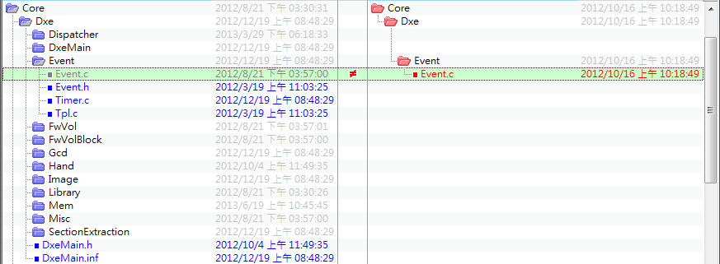
How to Use Override Example
Duplicate directory structure
Ex: Core/Dxe/Event
MdeModulePkg/Core/Dxe/DxeMain.inf {
<SOURCE_OVERRIDE_PATH>
MdeModulePkg/Override/Core/Dxe
}

Slide 23
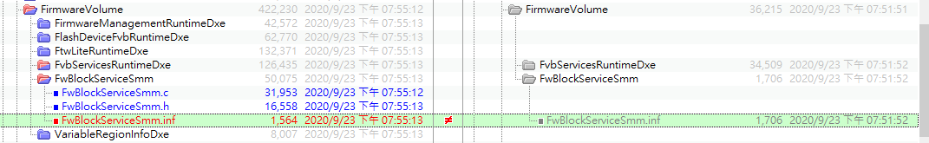
How to Use Override Example
Override the INF file only when it needs to change
Ex: Add GUID/Library Class/PPI/Protocol/PCD/Package/Depex/…
!disable InsydeModulePkg/Universal/FirmwareVolume/FwBlockServiceSmm/FwBlockServiceSmm.inf
InsydeModulePkg/Universal/FirmwareVolume/FwBlockServiceSmm/FwBlockServiceSmm.inf {
<SOURCE_OVERRIDE_PATH>
$(PROJECT_PKG)/Override/Insyde/InsydeModulePkg/Universal/FirmwareVolume/FwBlockServiceSmm
}

Slide 24
Thanks!

